Slide 1
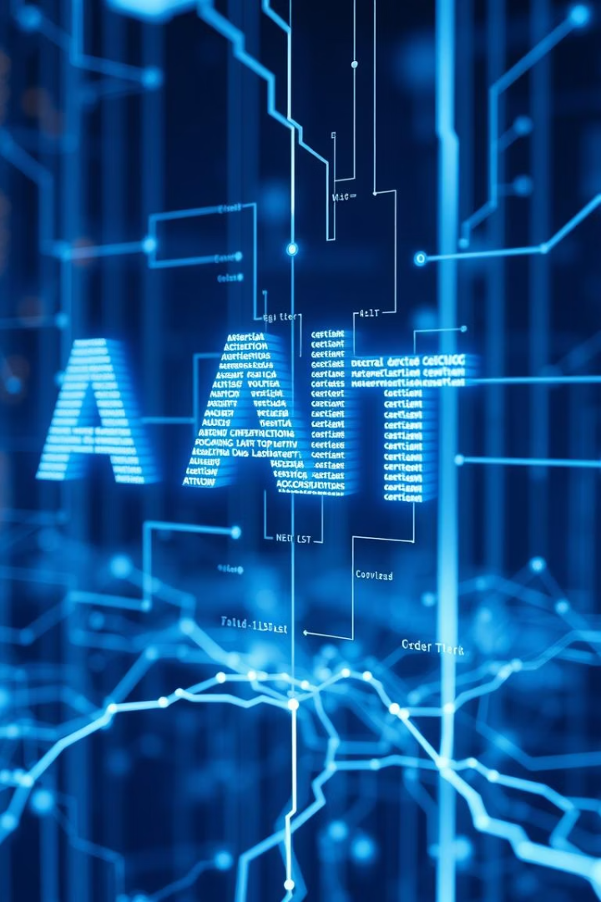
AI Text Detection Using GPT-2 Perplexity
Identifying AI-generated Text Using Language Model Perplexity

Slide 2

Introduction
Growing prevalence
Detection need
Project focus
AI-generated text is increasingly common in many applications.
Reliable methods are essential to distinguish AI from humans.
Using GPT-2 perplexity to identify AI-generated content.

Slide 3
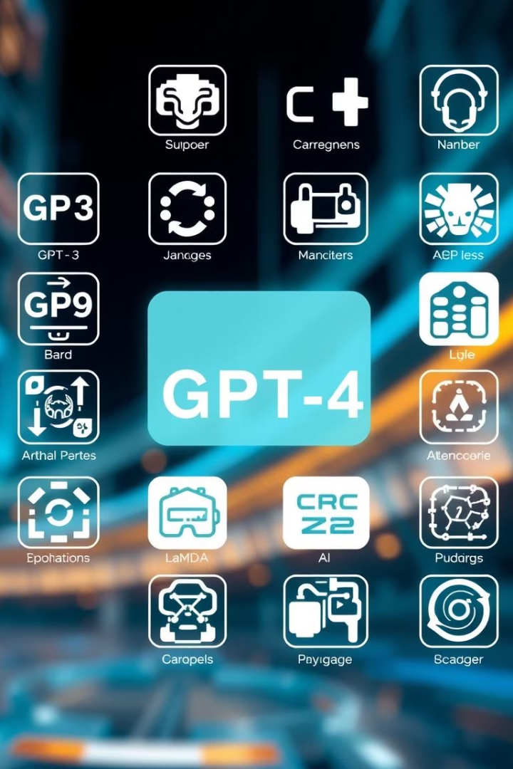
What Is AI-Generated Text?
Definition
Common tools
Text produced by artificial intelligence language models.
Includes GPT-3, GPT-4, Bard, LaMDA, and more.
Use cases
Content generation, chatbots, automation, and assistance.

Slide 4
Why Detecting AI Content Is Important
Combat misinformation
Uphold integrity
Reducing false or misleading content.
Protect academic honesty and professional ethics.
Ensuring authenticity and trustworthiness of sources.
Maintain transparency about content origins.

Slide 5
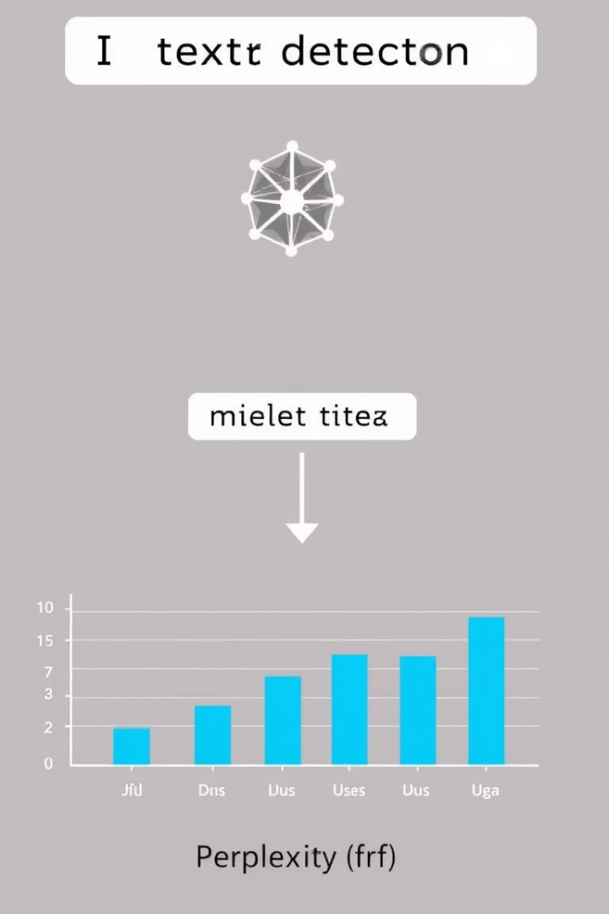



Project Objective
Detect text origin
Classify text as AI-generated or human-written.
Use GPT-2 perplexity
Measure how surprising or likely text is for the model.
Quantify likelihood
Provide a numeric score indicating AI content probability.

Slide 6
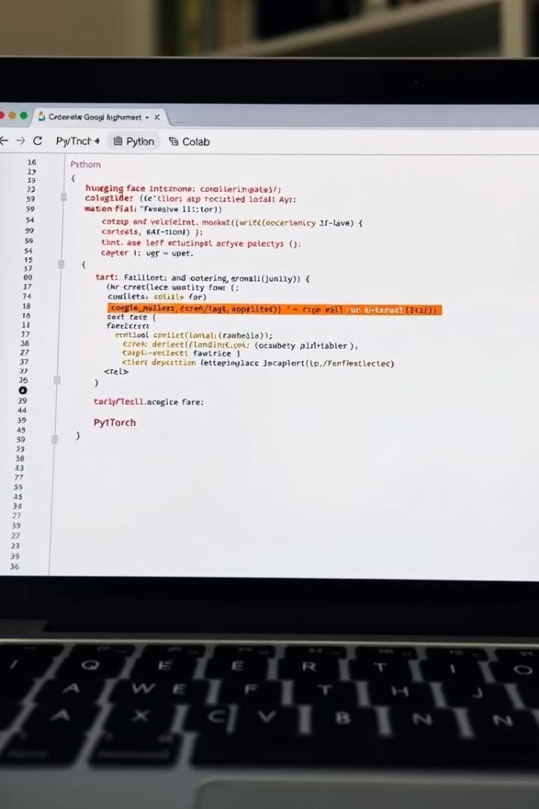




Tools & Technologies
Python
Google Colab
Hugging Face
Core programming language for implementation.
Free cloud platform for running experiments.
Library to access pre-trained models like GPT-2.
PyTorch
Deep learning framework supporting model computations.

Slide 7

How It Works
Upload text
Users submit text files to be analyzed.
Preprocess text
Tokenize text for model compatibility.
Calculate perplexity
GPT-2 generates a score indicating textual likelihood.

Slide 8
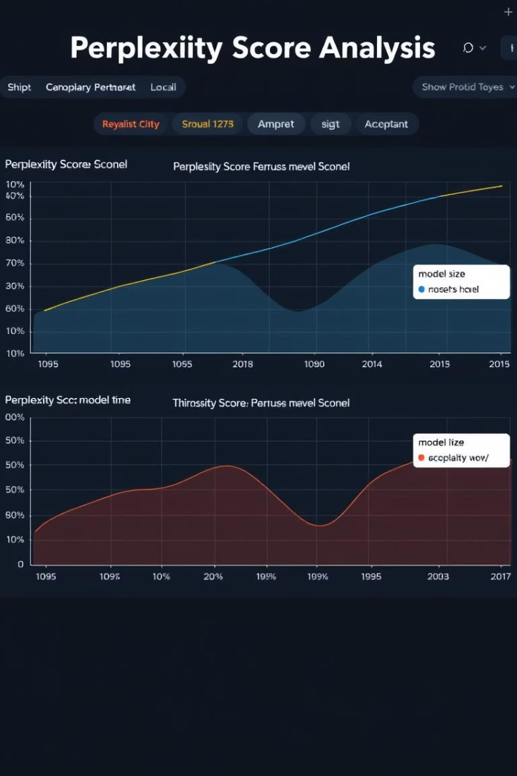
Next Steps: Analyzing Perplexity Scores
1
Set thresholds
2
Classify texts
Determine cutoff scores for classification.
Differentiate AI-generated vs human-written content.
3
Evaluate results
Assess accuracy and analyze limitations.

